Slide 1


Embedded System Introduction
Author. NghiaNV16
Aug 31 2023

Slide 2
1
1
Embedded System Introduction
CONTENT
2
Micro-Controller vs Micro-Processor
© Copyright FPT Software – Level of Confidentiality

Slide 3
01. Embedded System Introduction

Slide 4
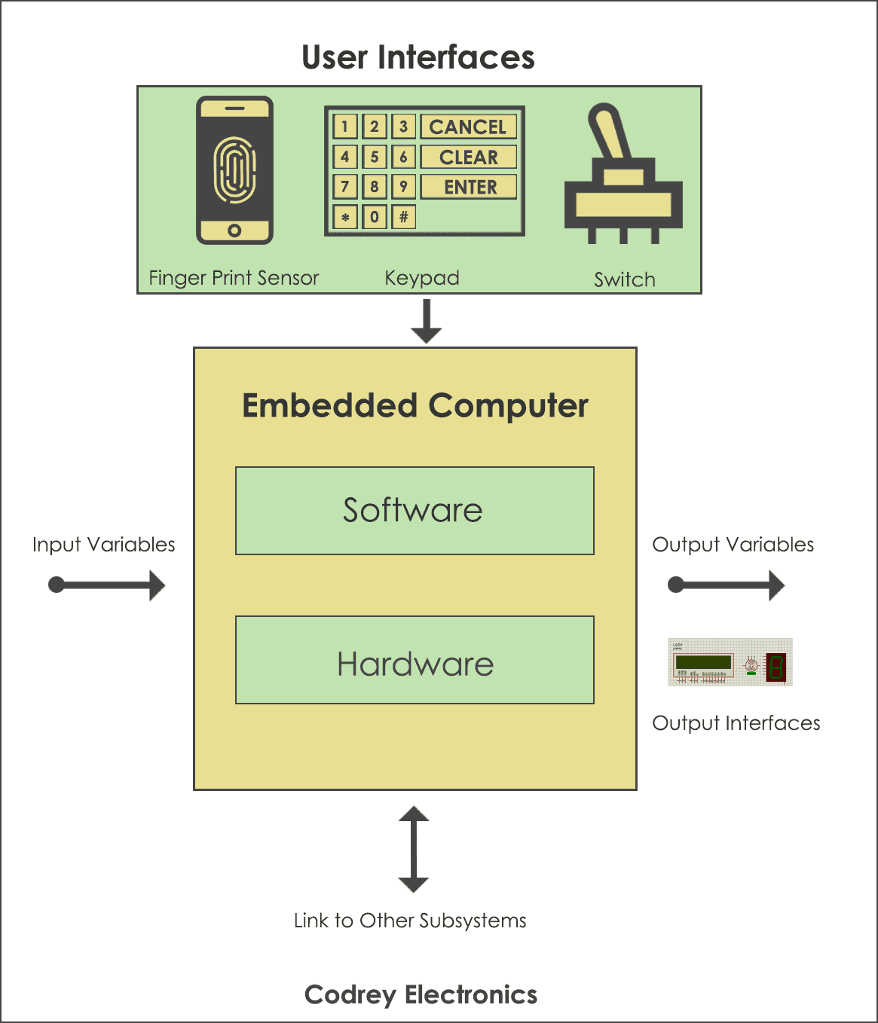
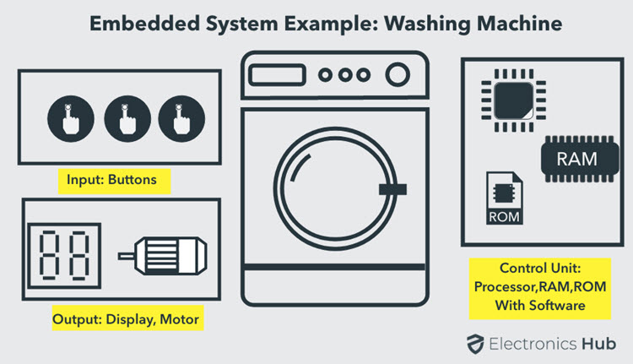
Embedded System Introduction
An embedded system is a computer system a combination of a computer processor, computer memory, and input/output peripheral devices
that has a dedicated function within a larger mechanical or electronic system.
It is embedded as part of a complete device often including electrical or electronic hardware and mechanical parts

Slide 5

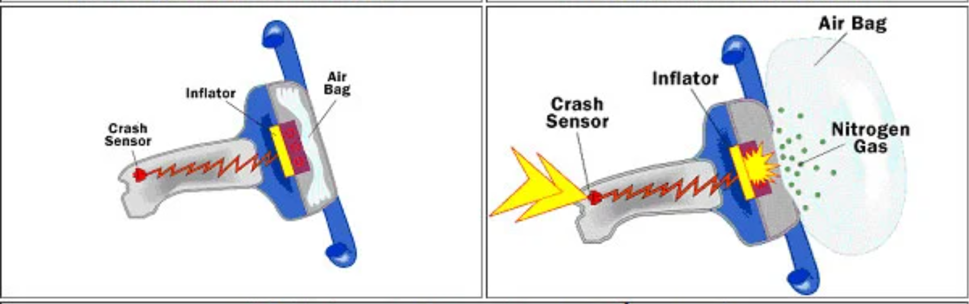
Embedded System Application
General Computing
Video games, set-top boxes, wearable computer
Control System
Vehicle engine, nuclear power, fight control
Signal Processing
Radar, Sonar, video compression.
Communication & Network
Telephone system, router

Slide 6
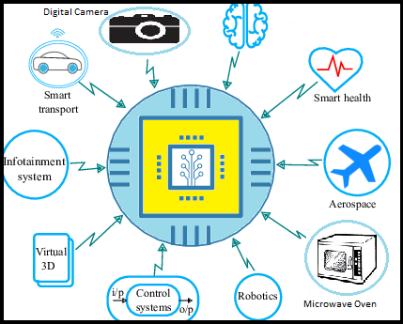
Embedded System Application

Slide 7
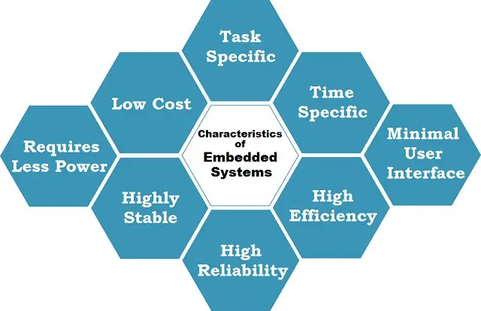
Embedded System Features
Embedded system is designed to perform some specific tasks.
The program written for embedded system is called “firm-ware”, and usually stored in persistence memory (rom/flash)
The firm-ware can run with limited hardware resourced.

Slide 8
02. Micro-Controller vs Micro-Processor

Slide 9
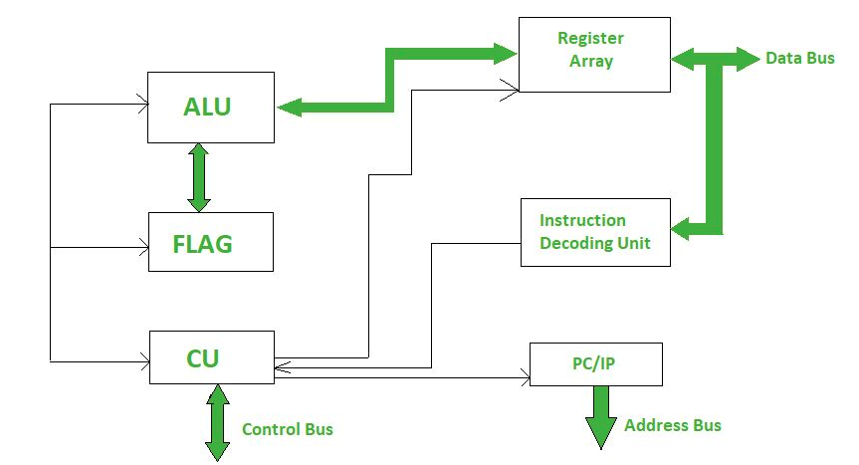
Micro-Processor
A microprocessor is a computer processor where the data processing logic and control is included on a single integrated circuit (IC)

Slide 10
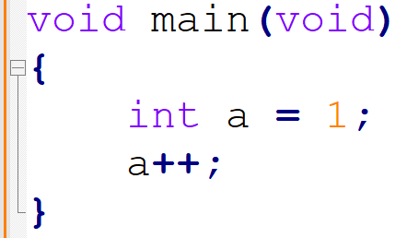
How does Micro-Processor perform a program
For Example. A C Program to increase a local variable

Slide 11

How does Micro-Processor perform a program
a = 1
Instruction (Text Code)
2
1

Slide 12
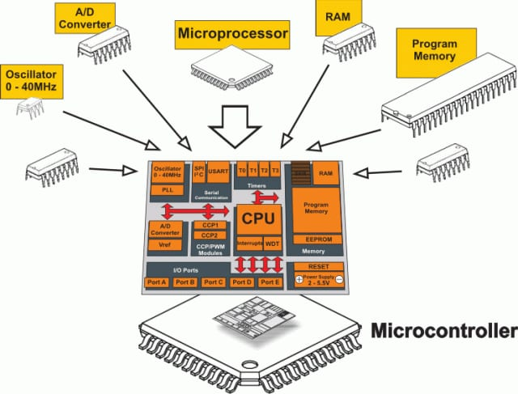
Micro-Controller
A microcontroller (MCU for microcontroller unit, also MC, UC, or μC) is a small computer on a single VLSI integrated circuit (IC) chip.
A microcontroller contains one or more CPUs (processor cores) along with memory and programmable input/output peripherals.

Slide 13
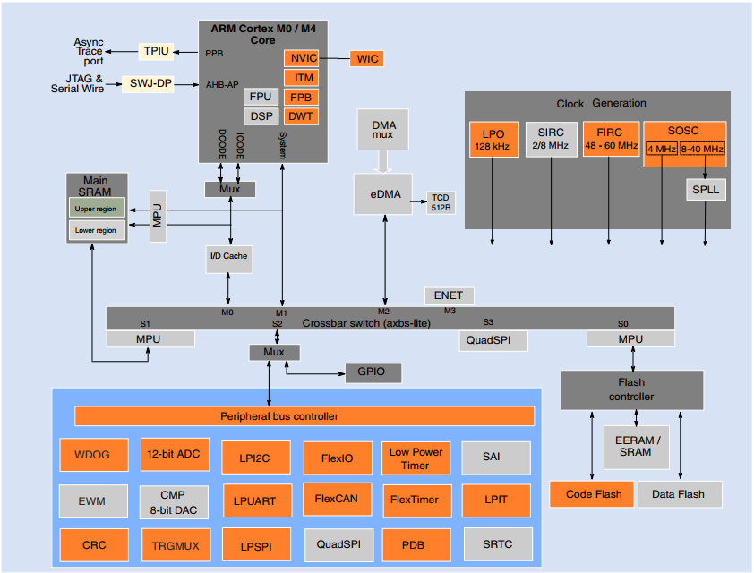
Micro-Controller and Micro-Processor in S32K144

Slide 14

CONTACT US
FPT Cau Giay Building, Duy Tan Street, Dich Vong Hau Ward, Cau Giay District, Hanoi City, Vietnam
Contact Person: Nghia Nguyen Van
Email: NghiaNV16@fpt.com

